Slide 1

Basic Laws
Discussion D2.1
Chapter 2
Sections 2-1 – 2-6, 2-10

Slide 2
Basic Laws
Ohm's Law
Kirchhoff's Laws
Series Resistors and Voltage Division
Parallel Resistors and Current Division
Source Exchange

Slide 3
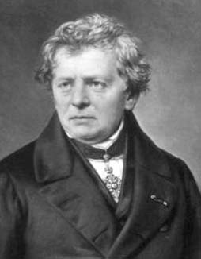
Georg Simon Ohm (1789 – 1854)
German professor who publishes a book in 1827 that includes what is now known as Ohm's law.
Ohm's Law: The voltage across a resistor is directly proportional to the currect flowing through it.
http://www-history.mcs.st-andrews.ac.uk/history/PictDisplay/Ohm.html

Slide 4
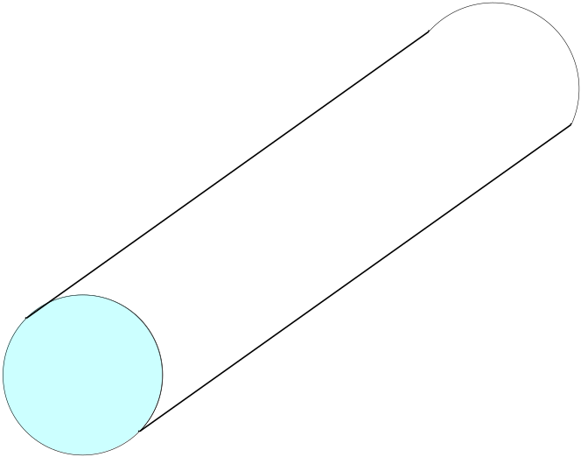
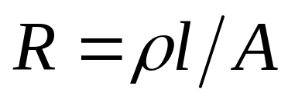
Resistance
ρ = resistivity in Ohm-meters
Resistance
l
= length
Good conductors (low ρ): Copper, Gold
A
Good insulators (high ρ): Glass, Paper

Slide 5
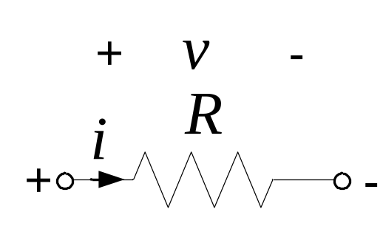
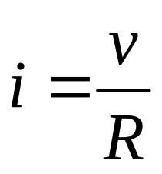
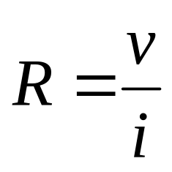
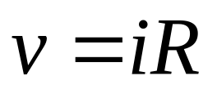
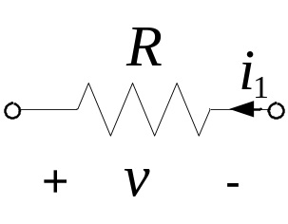
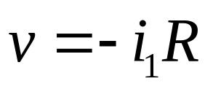
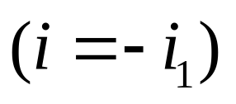

Ohm's Law
Units of resistance, R, is Ohms (Ω)
R = 0: short circuit
open circuit

Slide 6
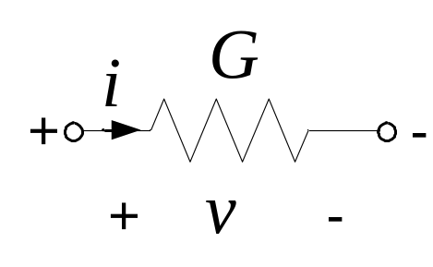
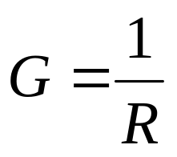
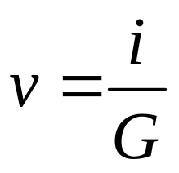
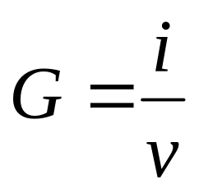
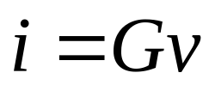
Conductance, G
Unit of G is siemens (S),
1 S = 1 A/V

Slide 7
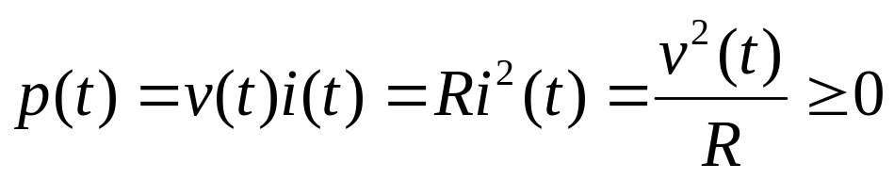
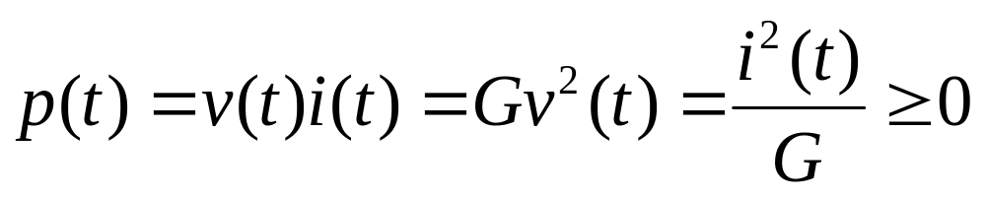
Power
A resistor always dissipates energy; it transforms electrical energy, and dissipates it in the form of heat.
Rate of energy dissipation is the instantaneous power

Slide 8
Basic Laws
Ohm's Law
Kirchhoff's Laws
Series Resistors and Voltage Division
Parallel Resistors and Current Division
Source Exchange

Slide 9
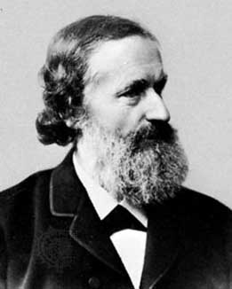
Gustav Robert Kirchhoff (1824 – 1887)
Born in Prussia (now Russia), Kirchhoff developed his "laws" while a student in 1845. These laws allowed him to calculate the voltages and currents in multiple loop circuits.
http://www-history.mcs.st-andrews.ac.uk/history/PictDisplay/Kirchhoff.html

Slide 10
CIRCUIT TOPOLOGY
Topology: How a circuit is laid out.
A branch represents a single circuit (network) element; that is, any two terminal element.
A node is the point of connection between two or more branches.
A loop is any closed path in a circuit (network).
A loop is said to be independent if it contains a branch which is not in any other loop.

Slide 11
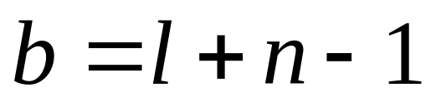
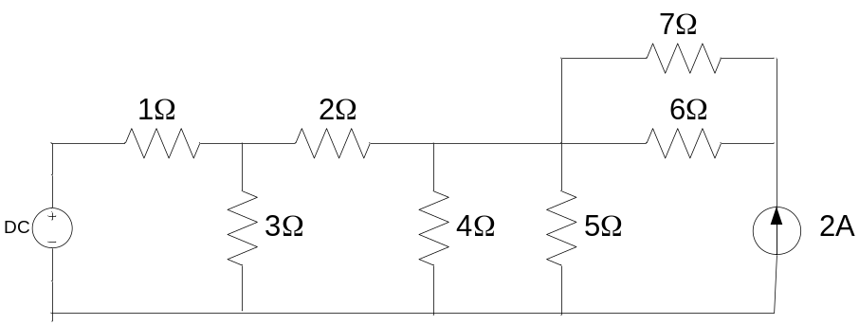
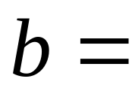
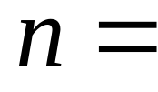
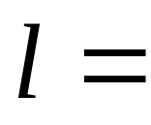
Fundamental Theorem of Network Topology
For a network with b branches, n nodes
and l independent loops:
Example
9
5
5

Slide 12
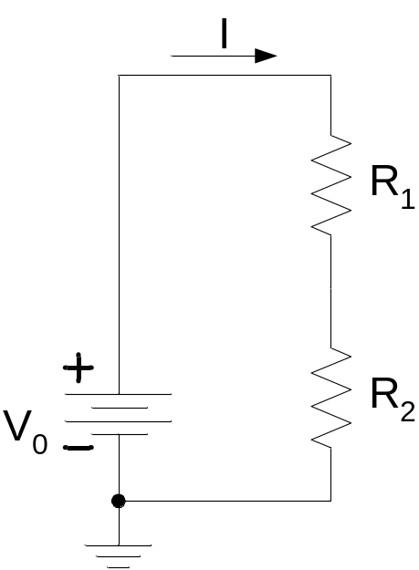
Elements in Series
Two or more elements are connected in series if they carry the same current and are connected sequentially.

Slide 13
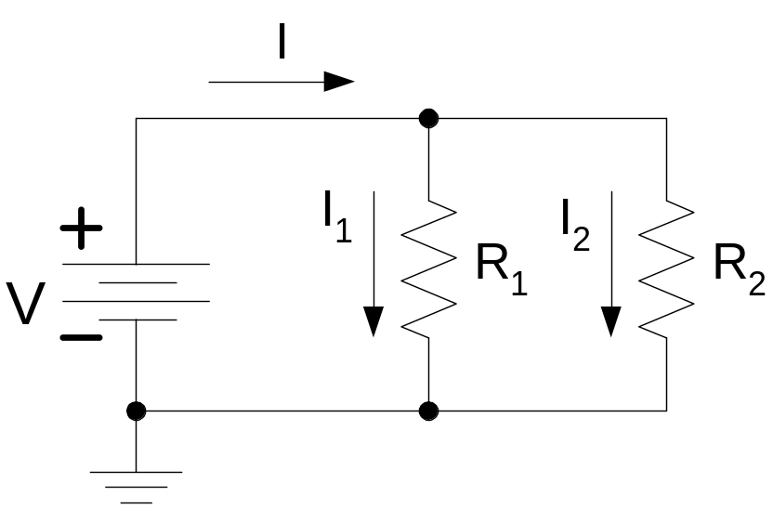
Elements in Parallel
Two or more elements are connected in parallel if they are connected to the same two nodes & consequently have the same voltage across them.

Slide 14
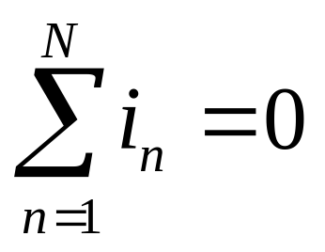
Kirchoff’s Current Law (KCL)
The algebraic sum of the currents entering a node (or a closed boundary) is zero.
where N = the number of branches connected to the node and i_{n} = the n^{th} current entering (leaving) the node.

Slide 15





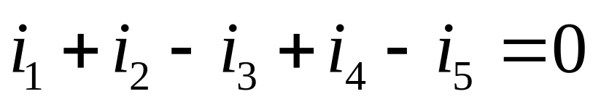
Sign convention: Currents entering the node are positive, currents leaving the node are negative.

Slide 16
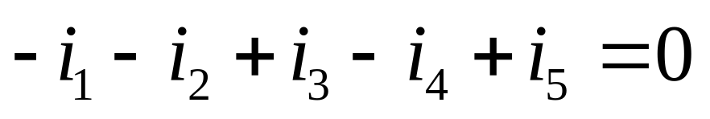
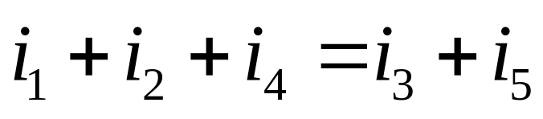
Kirchoff’s Current Law (KCL)
The algebraic sum of the currents entering (or leaving) a node is zero.
Entering:
Leaving:
The sum of the currents entering a node is equal to the sum of the currents leaving a node.

Slide 17
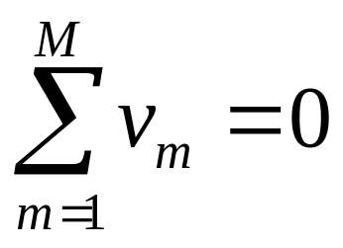
Kirchoff’s Voltage Law (KVL)
The algebraic sum of the voltages around any loop is zero.
where M = the number of voltages in the loop and v_{m} = the m^{th} voltage in the loop.

Slide 18
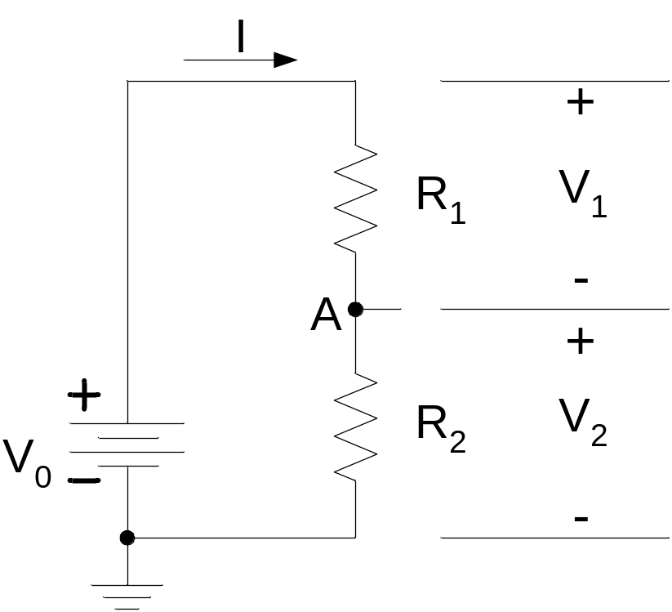
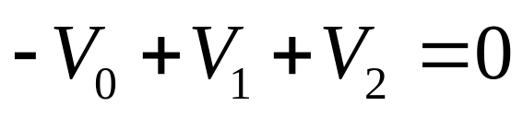
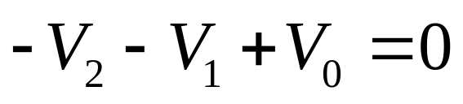
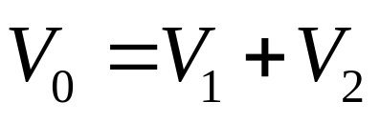
Sign convention: The sign of each voltage is the polarity of the terminal first encountered in traveling around the loop.
The direction of travel is arbitrary.
Clockwise:
Counter-clockwise:

Slide 19
Basic Laws
Ohm's Law
Kirchhoff's Laws
Series Resistors and Voltage Division
Parallel Resistors and Current Division
Source Exchange

Slide 20

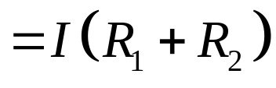
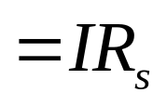
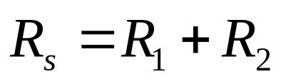
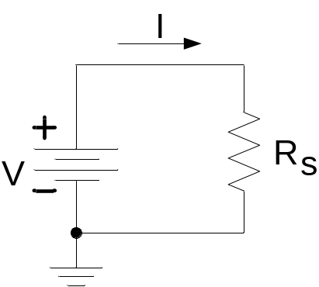
Series Resistors

Slide 21
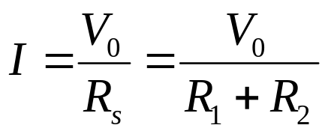
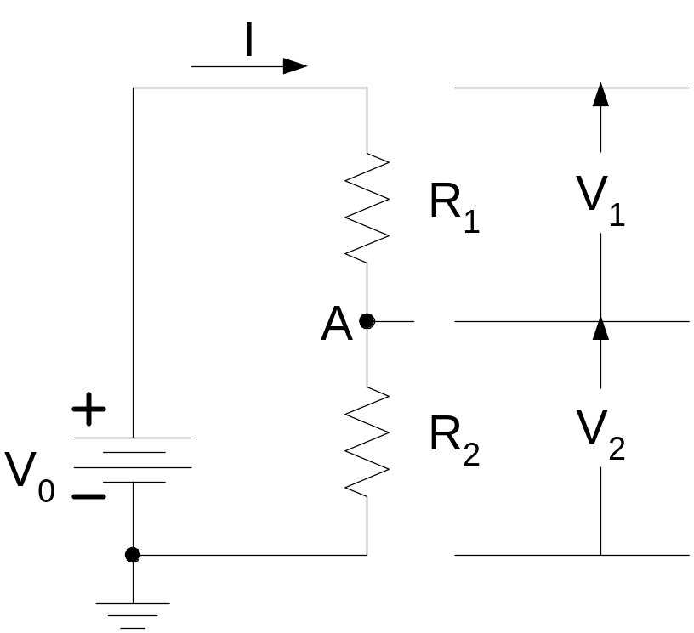
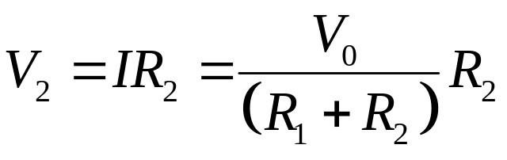
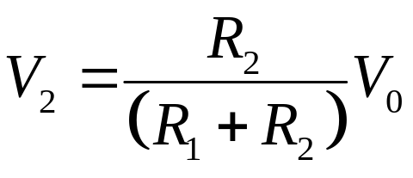
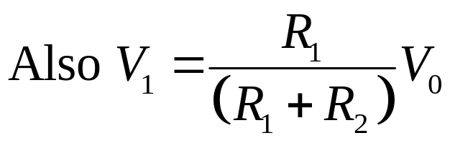
Voltage Divider

Slide 22
Basic Laws
Ohm's Law
Kirchhoff's Laws
Series Resistors and Voltage Division
Parallel Resistors and Current Division
Source Exchange

Slide 23
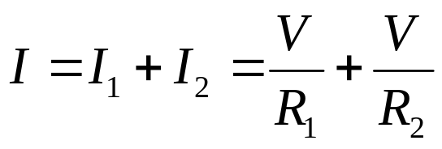
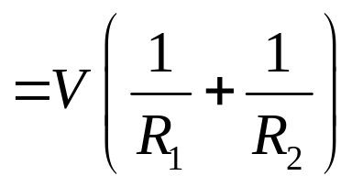
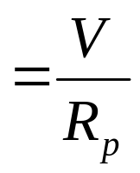
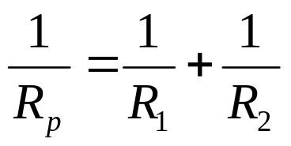
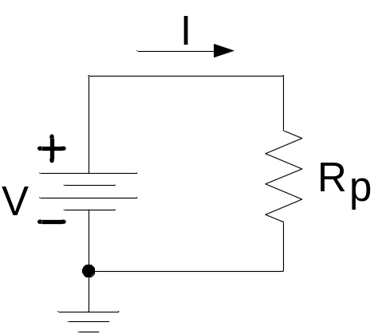
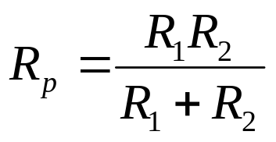
Parallel Resistors

Slide 24
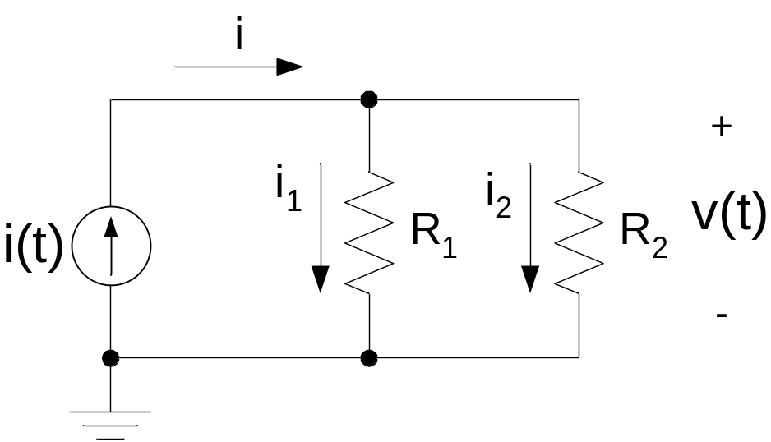



Current Division
Current divides in inverse proportion to the resistances

Slide 25



Current Division
N resistors in parallel
Current in j^{th} branch is

Slide 26
Basic Laws
Ohm's Law
Kirchhoff's Laws
Series Resistors and Voltage Division
Parallel Resistors and Current Division
Source Exchange

Slide 27

Source Exchange
We can always replace a voltage source in series with a resistor by a current source in parallel with the same resistor and vice-versa.
Doing this, however, makes it impossible to directly find the original source current.

Slide 28





Source Exchange Proof
Voltage across and current through any load are the same

